Slide 1
Analysis of MBTA Commuter Rail Electrification

Slide 2
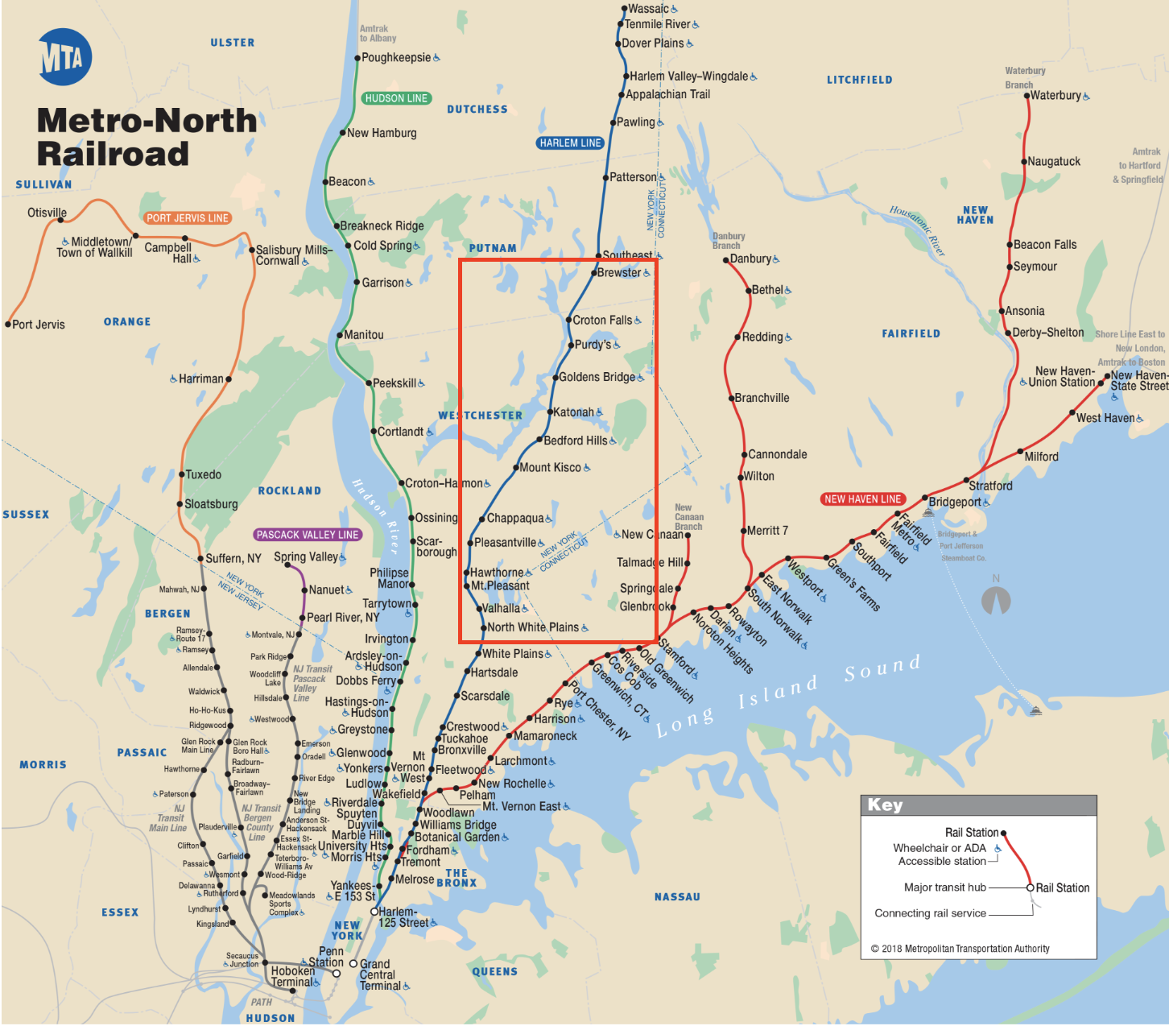
Extended electrification of Metro North Harlem Line in 1984

Slide 3
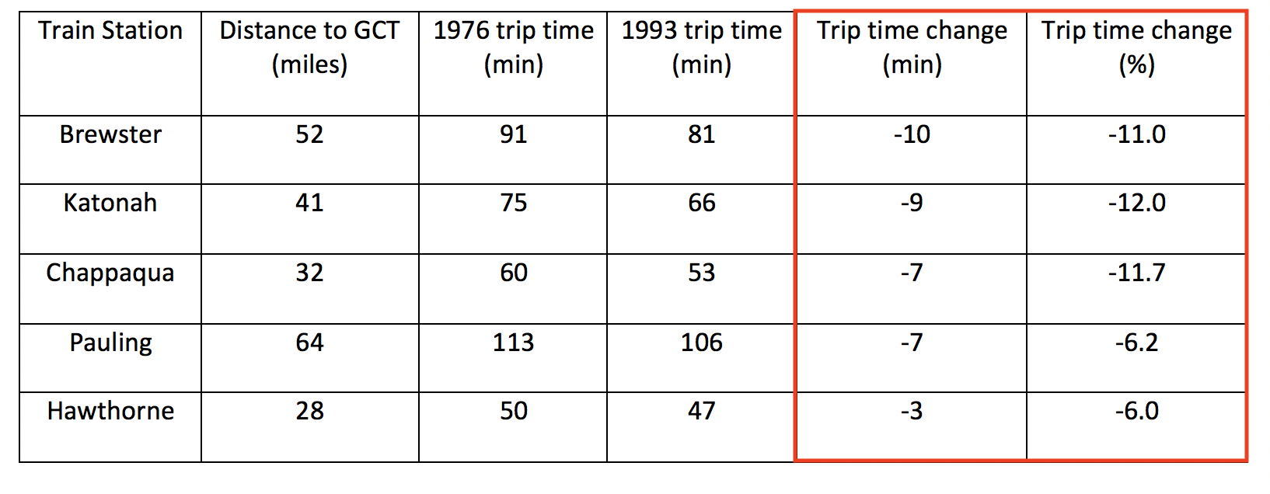
Effect of electrification and high-level platforms on trip times
Notes:
http://www.businessfairfield.com/wp-content/uploads/2014/12/TIMETABLE-STUDY-FINAL.pdf

Slide 4
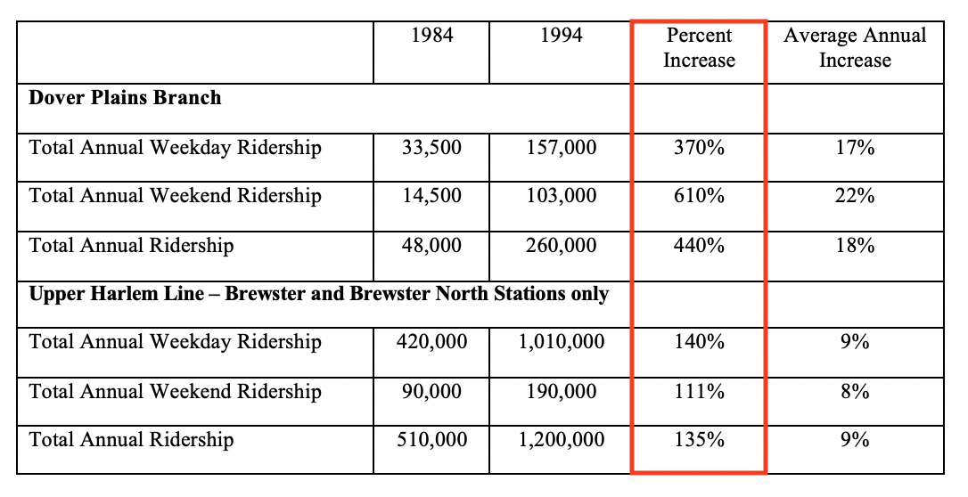
Effect of electrification and high-level platforms on ridership
Notes:
https://books.google.com/books?id=BiA3AQAAMAAJ&pg=SA26-PA68&dq=harlem+division&hl=en&sa=X&ved=0ahUKEwieobXd9MrUAhUCNz4KHe55BsM4FBDoAQgqMAE#v=onepage&q&f=false

Slide 5
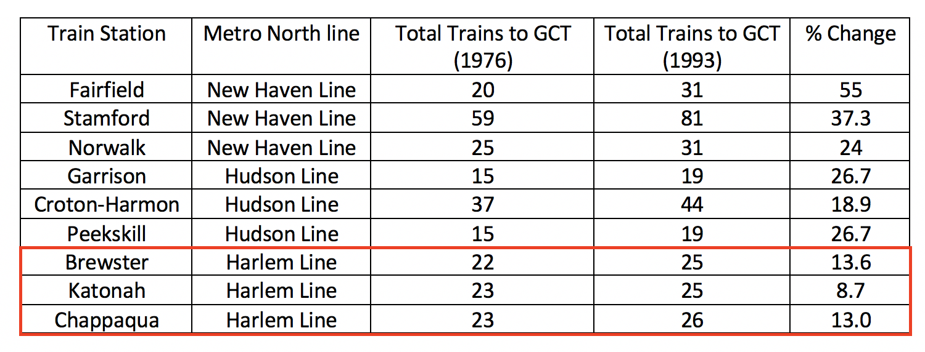
Controlling for other variables
Ridership growth on other Metro North lines not nearly as dramatic
Population growth in region served by Harlem Line not substantial
Increase in frequency of train service no different from other lines
Notes:
http://www.businessfairfield.com/wp-content/uploads/2014/12/TIMETABLE-STUDY-FINAL.pdf

Slide 6
Guiding question
How many new riders would the MBTA add from the trip time savings associated with the electrification of its commuter rail system?

Slide 7
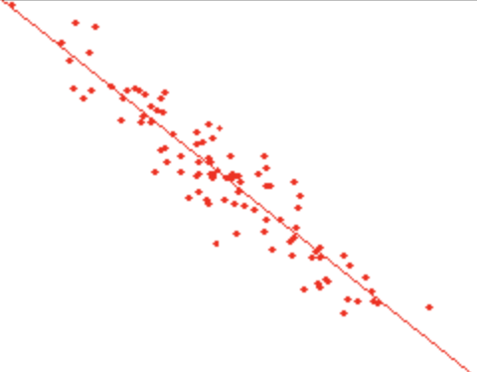
Expected results before conducting analysis
# of additional riders from municipality X: (0.8-0.6) * # of commuters from municipality X
0.8
Proportion of residents who take commuter rail
0.6
Time savings associated with electrification
Time savings from taking train instead of driving (%)

Slide 8
Methodology Part A: Proportion of commuters taking commuter rail
Data source: U.S. Census Bureau 2009-2013 Commuting Flows by Travel Mode
Focus on commuters into Boston since 84% of inbound commuter rail riders commute to Boston (2008-2009 Commuter Rail Passenger Survey)
#
MOE
Notes:
Central Transportation Planning Staff.“MBTA Systemwide Passenger Survey: All Lines 2008-09 Commuter Rail.”2010. Web. 12 Feb. 2018.

Slide 9
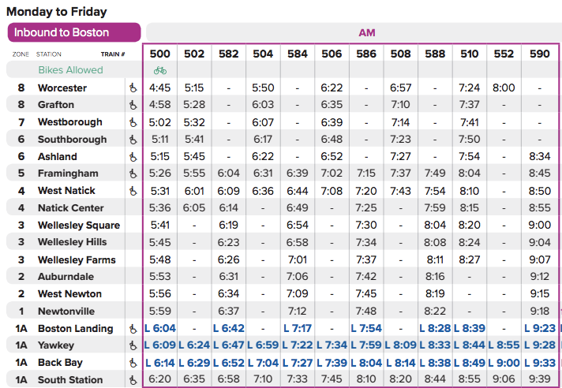
Methodology Part B: Trip time using commuter rail

Slide 10
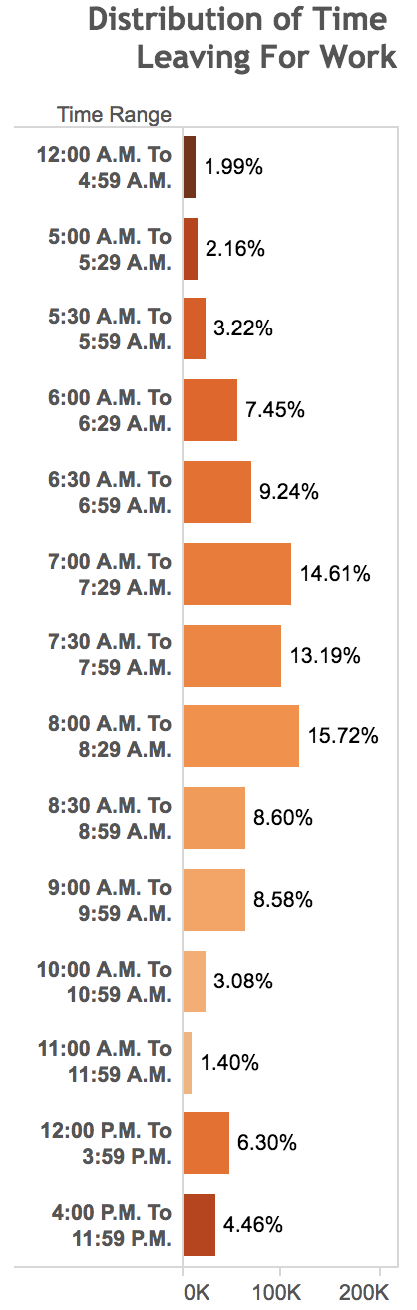
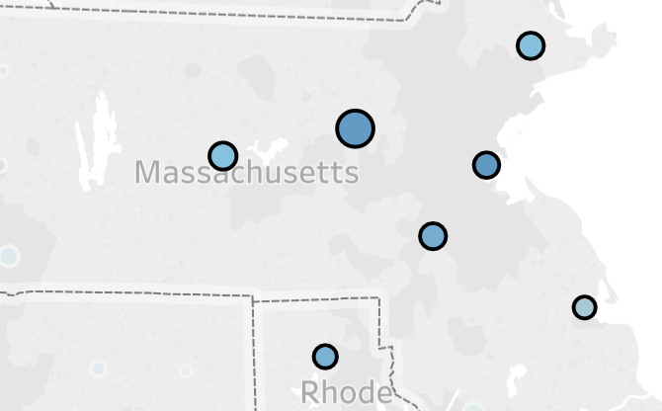
Methodology Part C: Trip time by car

Slide 11
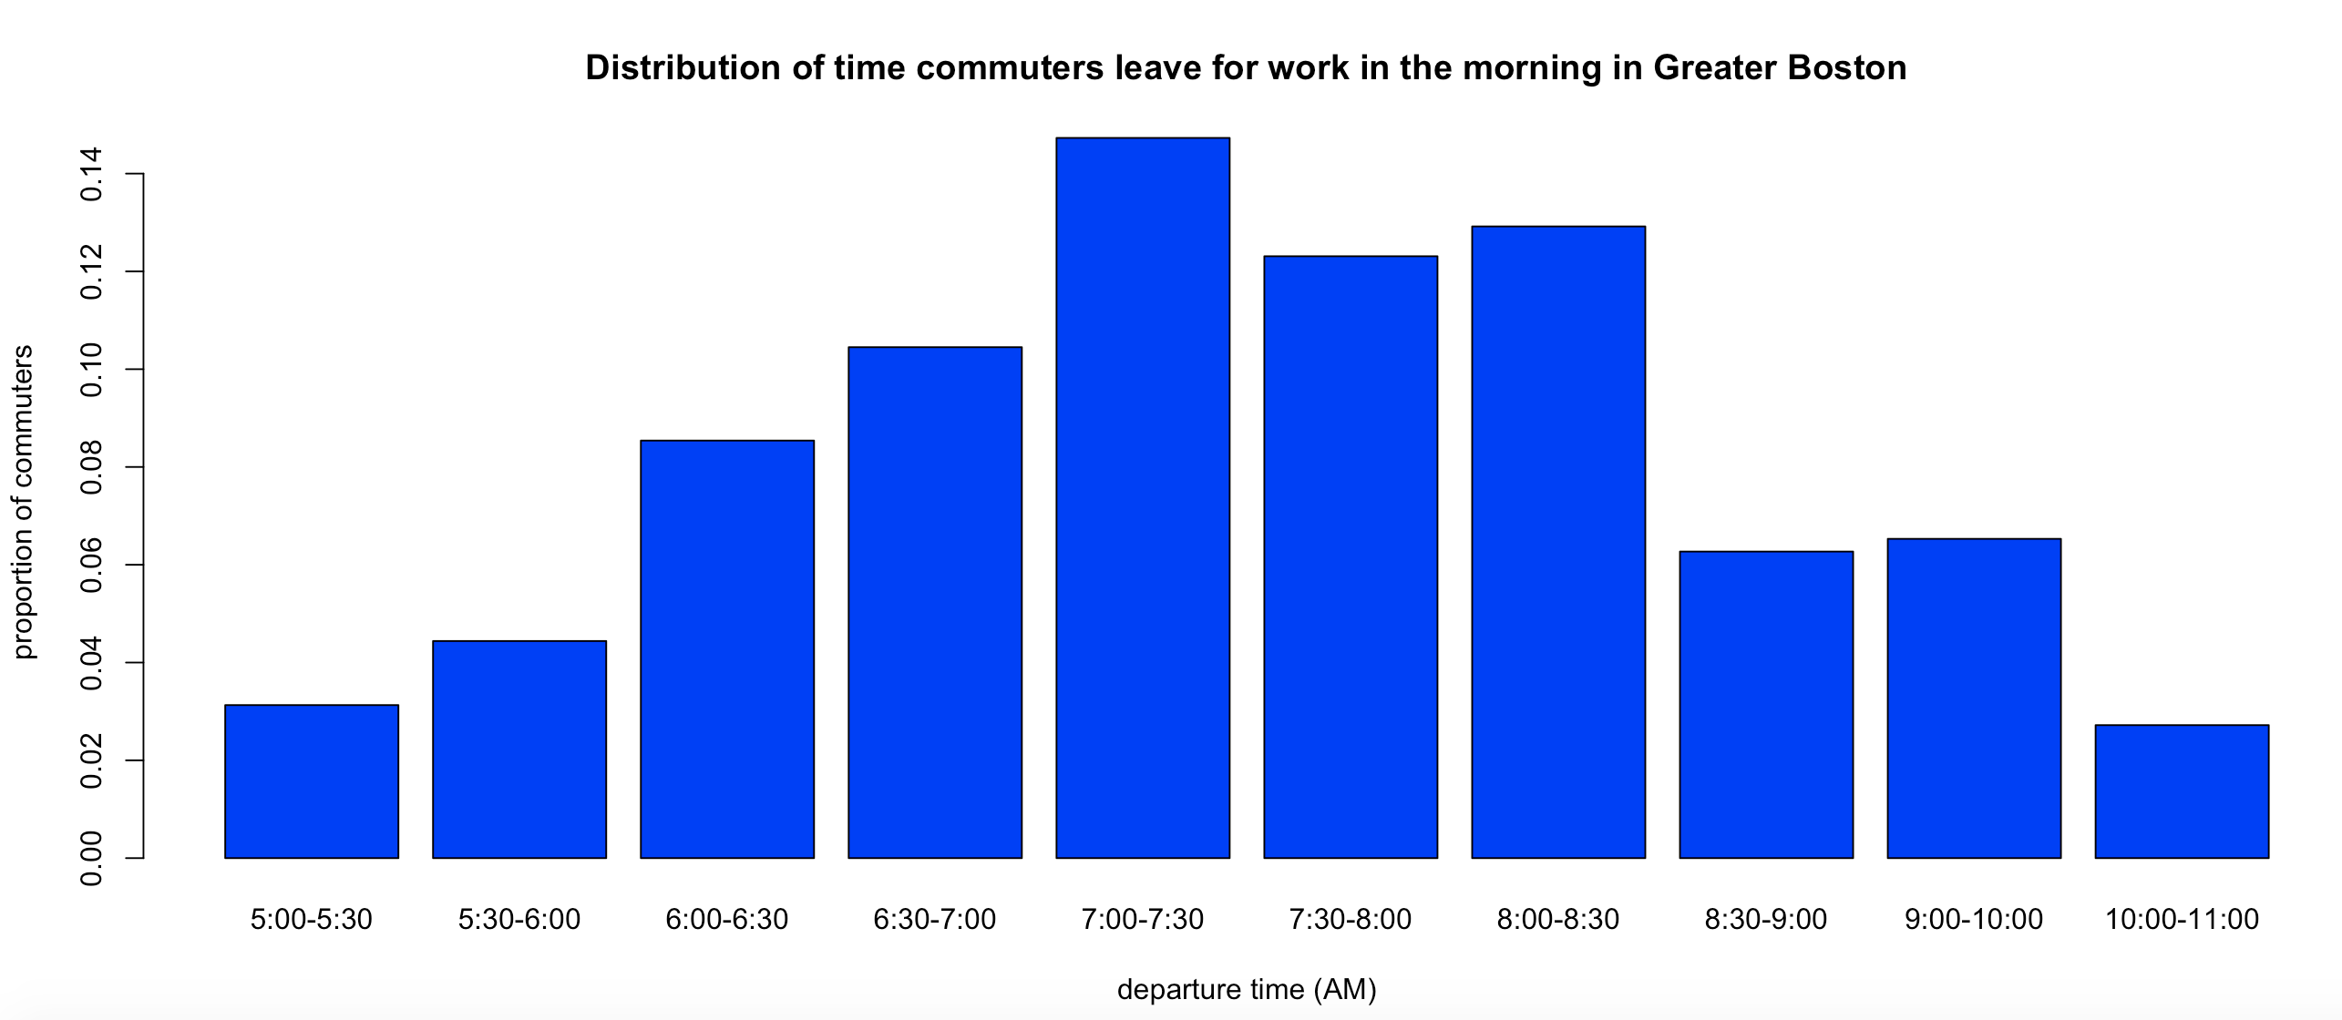
Methodology Part C: Trip time by car (cont.)

Slide 12
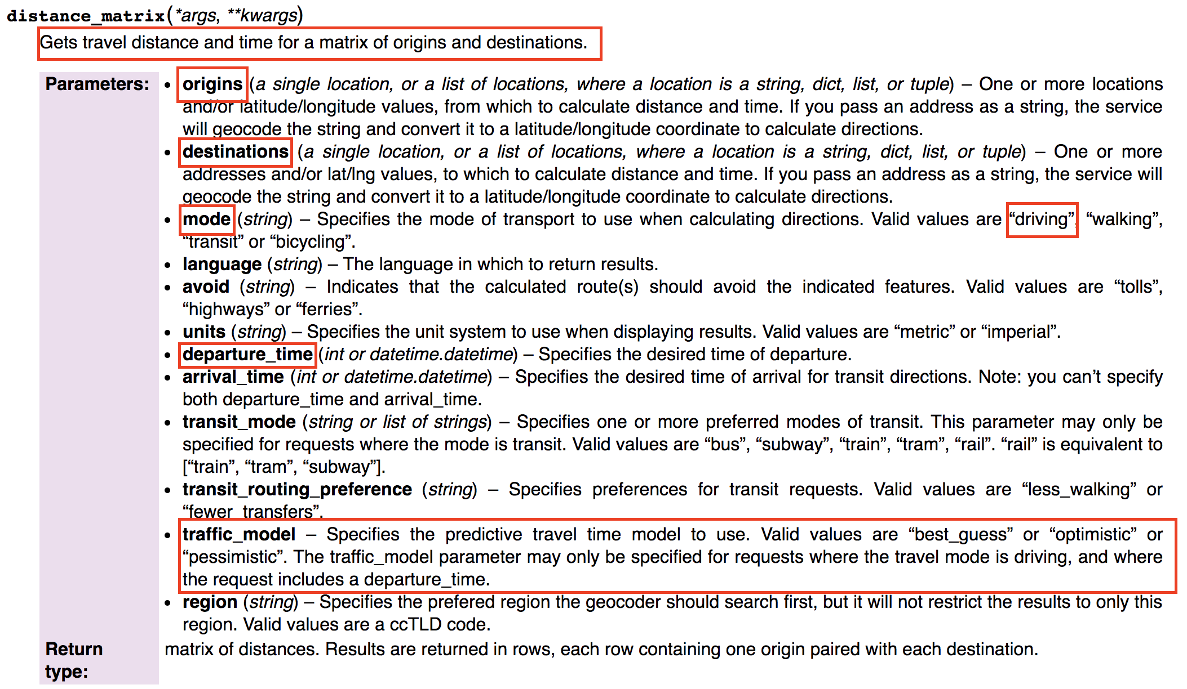

Slide 13
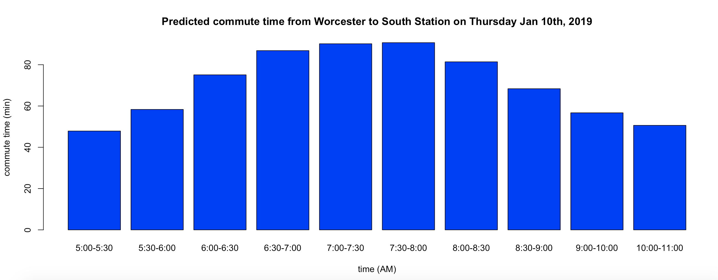
Methodology Part C: Trip time by car (cont.)

Slide 14
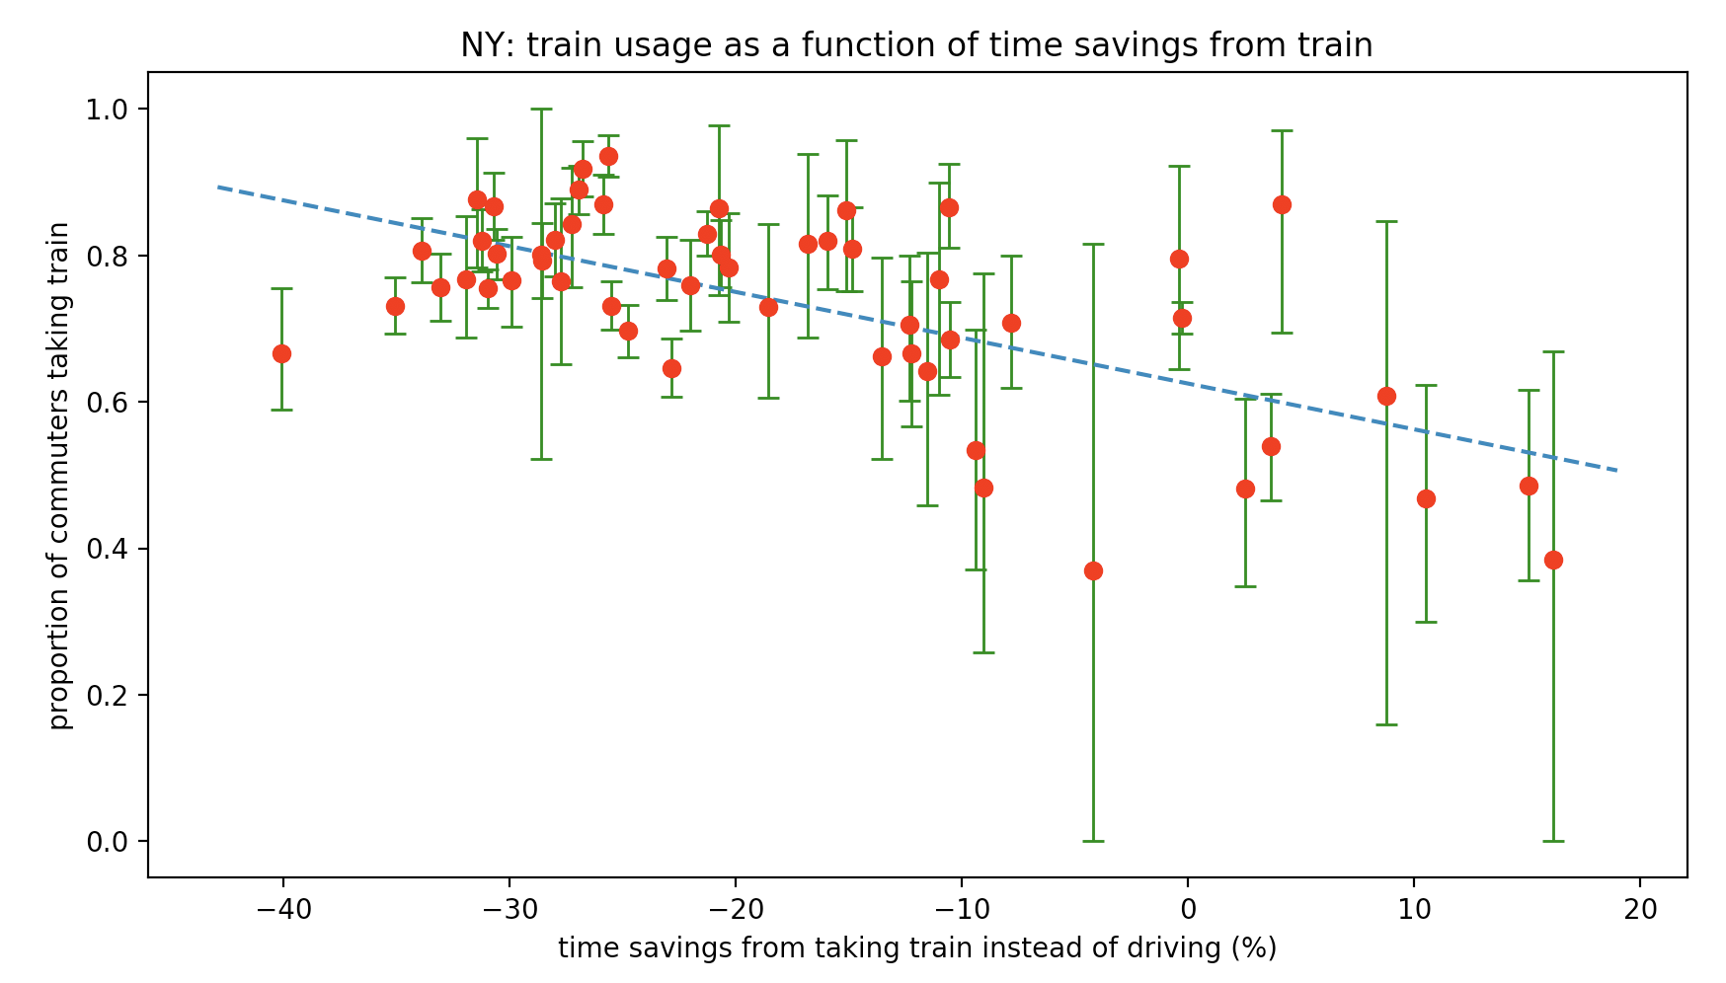
Slope: -0.00625
95% confidence interval:
[-0.00838, -0.00412]

Slide 15
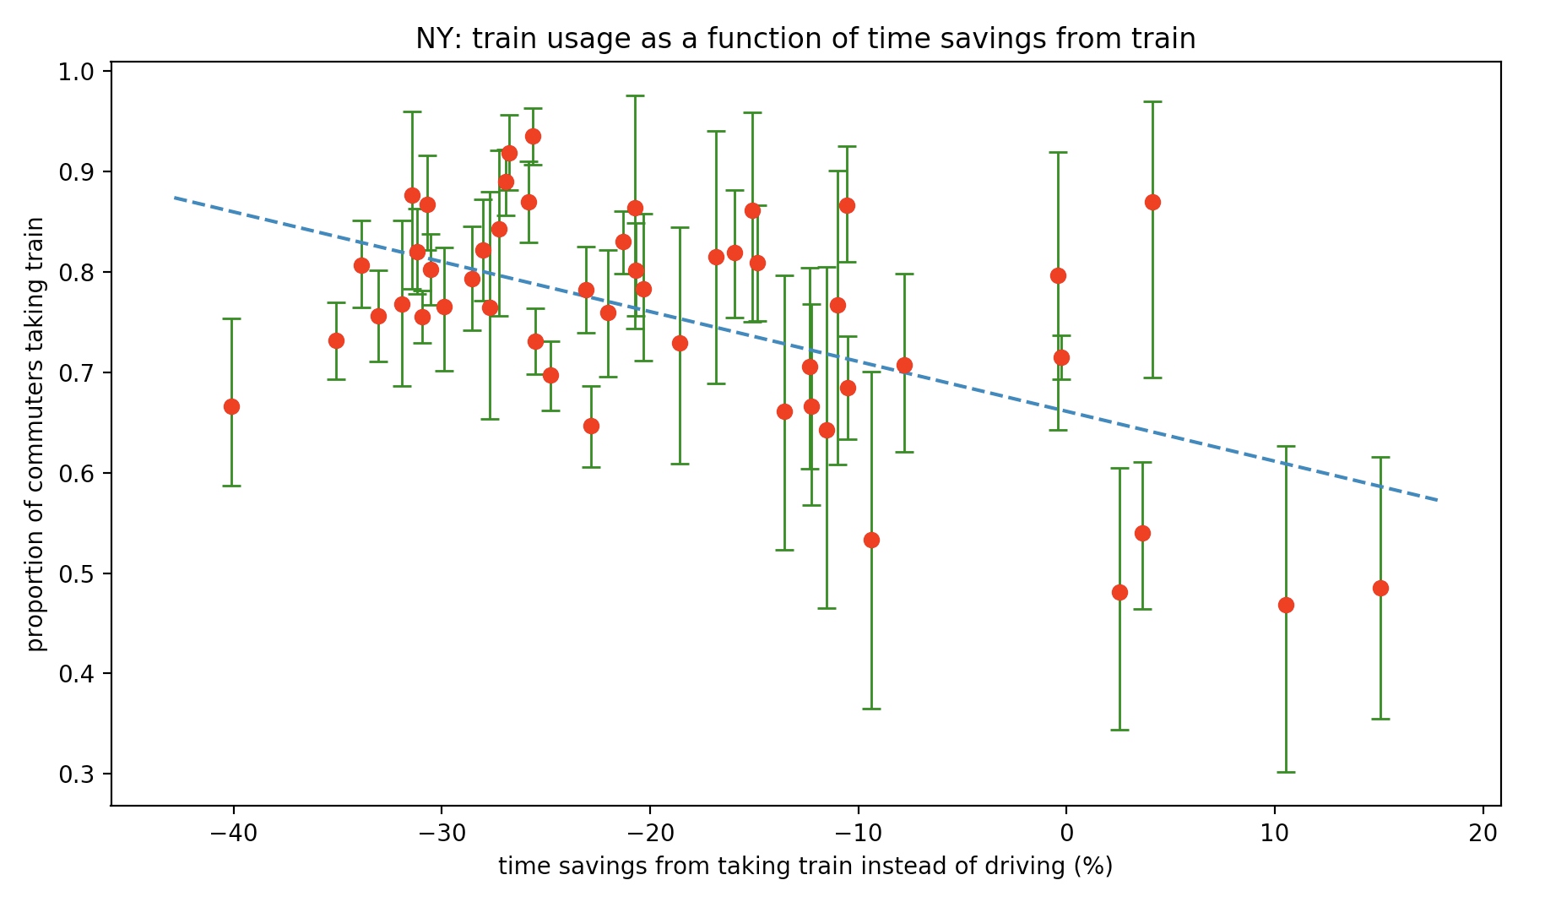
Slope: -0.00496
95% confidence interval:
[-0.00713, -0.00280]
Notes:
R^2 = 0.122

Slide 16
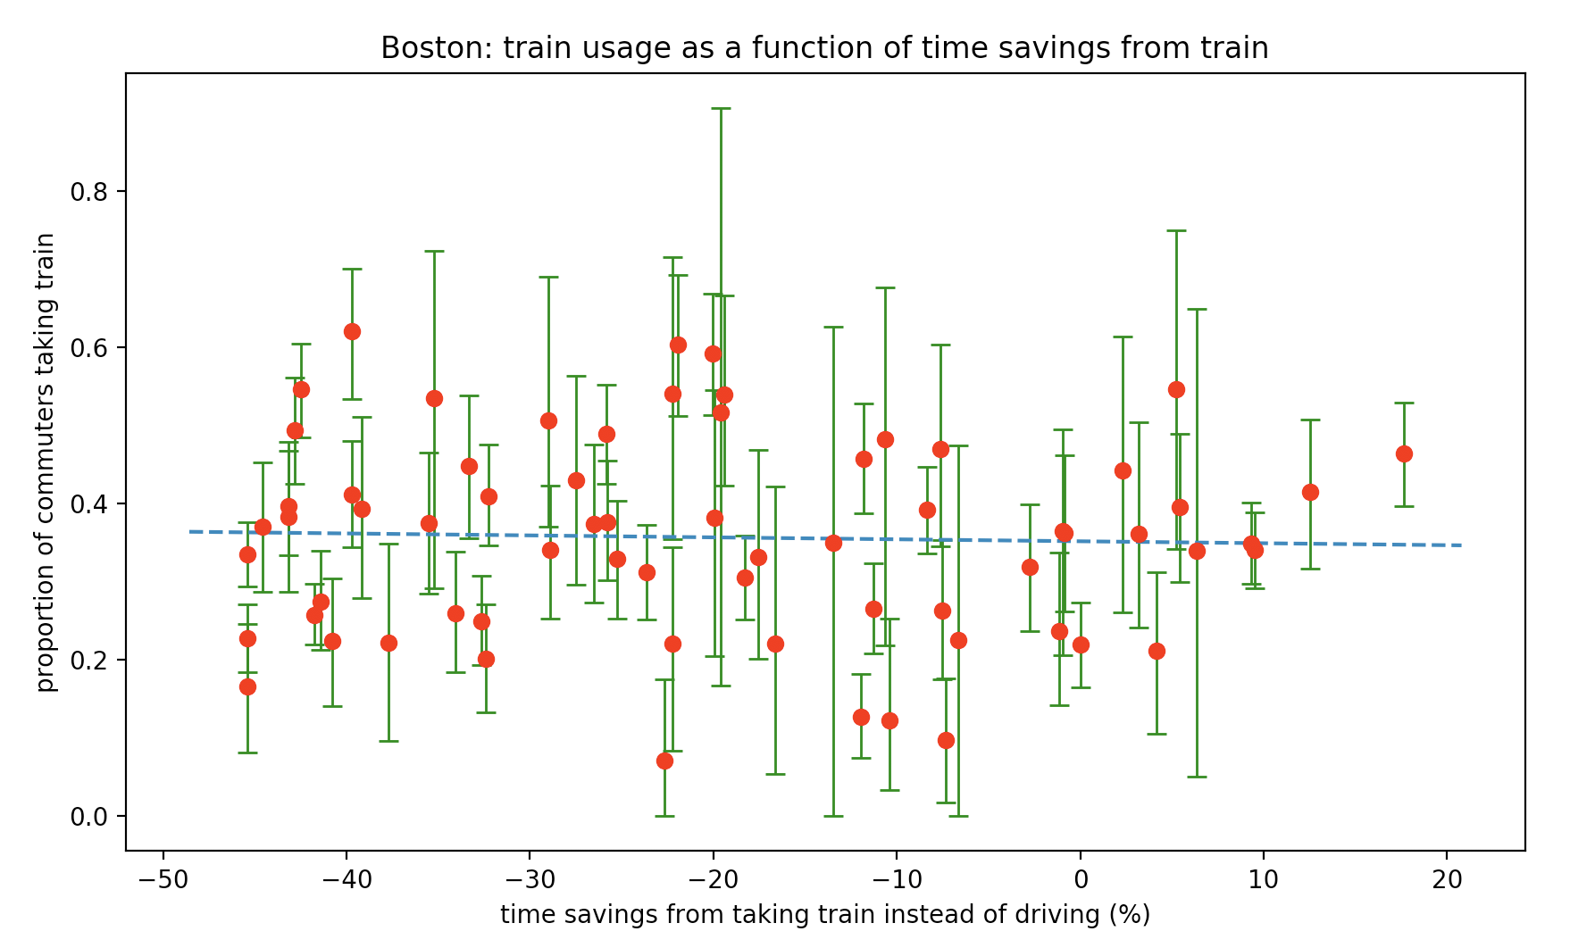
Slope: -0.00025
95% confidence interval: [-0.00186, 0.00166]
Notes:
0.001156

Slide 17
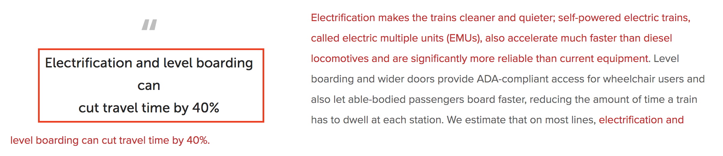
Transit Matters Claim

Slide 18
Train speeds: Boston vs. New York
 | Average speed (MPH) | Average miles per stop (mi)
MBTA | 32.54 | 4.21
Metro North | 34.66 | 3.91
LIRR | 31.11 | 4.29

Slide 19
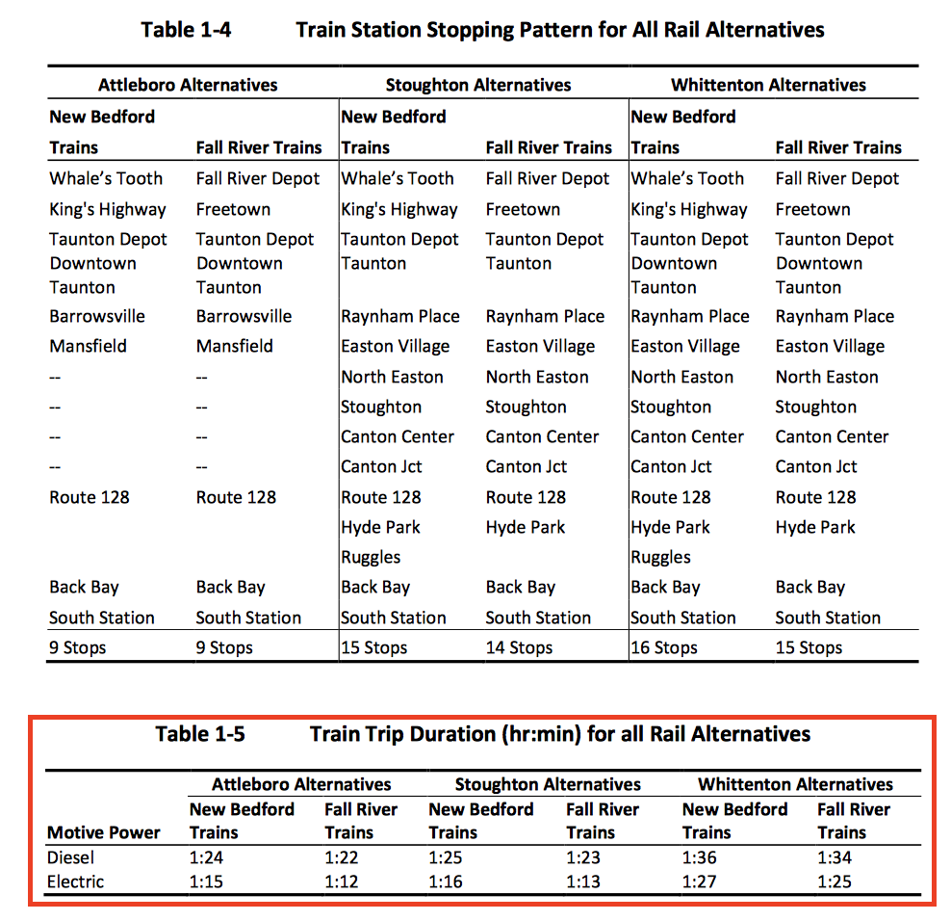
South Coast Rail diesel vs. electric analysis (USACE)
Average time savings due to electrification: 10.75%

Slide 20
MBTA diesel vs. electric analysis methodology
Trip Time (min) | Number of stops
10 | 0
12 | 1
14 | 2
16 | 3
Inference: each stops adds two minutes to total trip time

Slide 21
MBTA diesel vs. electric analysis results
Commuter Rail System | Cost per station (sec)
Metro North | 59.1
LIRR | 73.3
MBTA | 103.6
Effect of electrification
Time savings per station : 37.4 seconds
Average trip time savings : 8.03%

Slide 22
Boston: projected train times after electrification
 | Average time savings (%) | Standard Deviation (%)
Current | -19.97 | 17.27
Post-electrification | -28.57 | 15.41

Slide 23
Conclusions
The faster travel times associated with electric trains would not significantly boost MBTA commuter rail ridership
The time savings due to electrification would not be nearly as large as claimed by Transit Matters

Slide 24
What I’m not concluding
Electrification won’t have a major impact on commuter rail ridership
Consequences of electrification that may increase ridership:
More frequent train service
Higher on-time performance
Increased reliability
The MBTA shouldn’t electrify its commuter rail system
Other benefits include:
Less pollution
Lower maintenance costs
Improved system reliability

